Slide 1
3D Object Based Model of Solar System
Team: Fake Astronauts
Nikolai Panergo, Zilin Dong, Zachary Hosek, Claudia Soria, David Saval

Slide 2
Introduction
Task: Create a class based 3D model and animation of our Solar System
Overview: We had class based system set up for our solar system which had an add body, draw, get position, and motion functions. We had a second body class for generating the bodies(planets). We had used different a couple different ODE methods to try and decide what we wanted to use. We tested Euler, Euler Cromer, Midpoint, and 4th Runge-Kutta methods. We finished the project by completing our class based system, finding actual data for planet positions using the skyfield library, creating graphics and datasets, and finally using our class based system to animate the solar system using plotly.

Slide 3
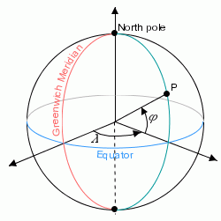
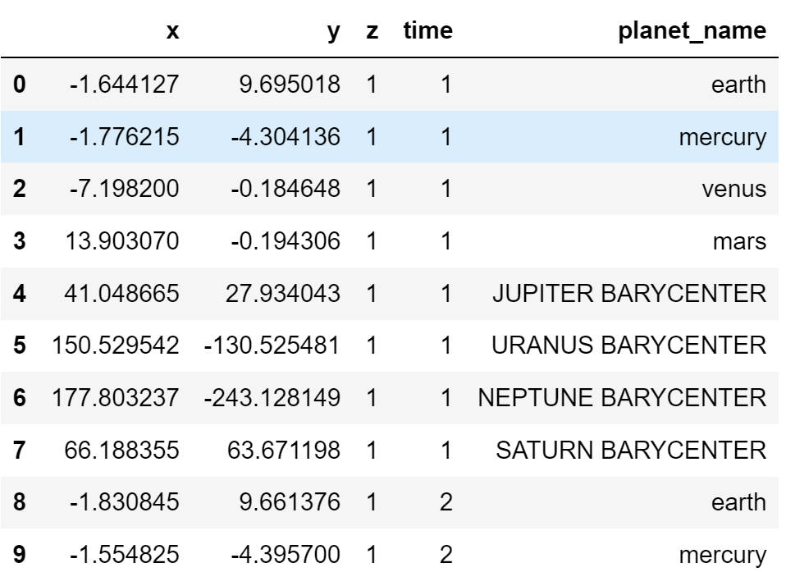
Using Actual Data
Used the python skyfield astronomy library, which has accurate estimations of planet positions up to 0.0005 arcseconds (very very accurate) with the astronomical almanac by the Navy
Heliocentric orbits, converting heliocentric coordinates into x,y,z, with the Sun’s position at (0,0,1)
Units are in AU, which are 150 million kilometers
Data is incremented by a day, every day in 2000 upto 2001
Time measured in UTC, or Greenwich time
Notes:
Zach

Slide 4
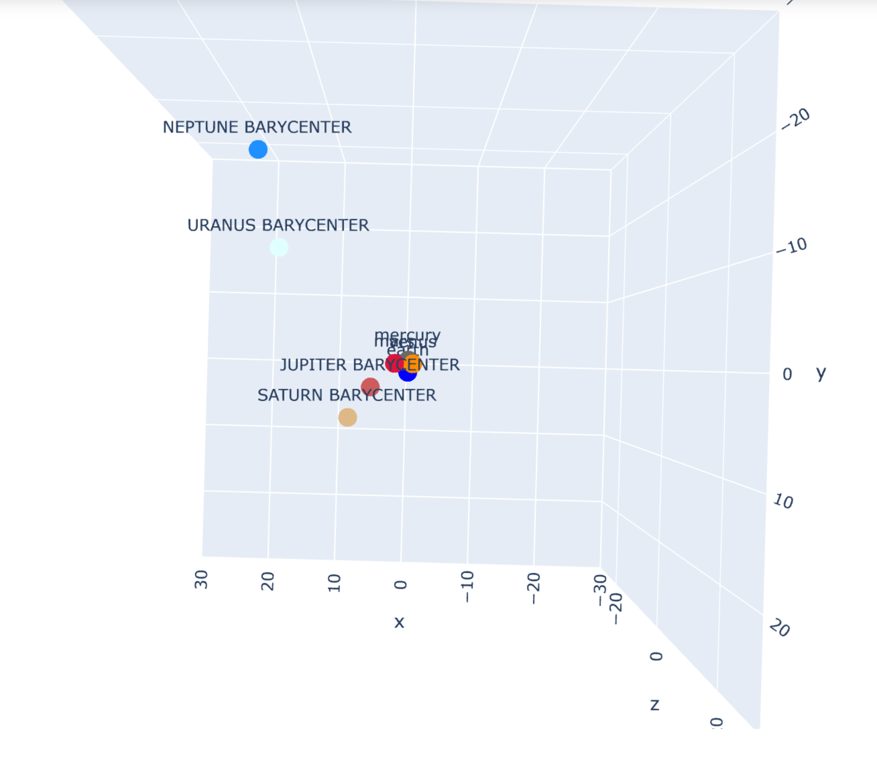
Creating a Simulation
Using the initial data from the SkyField dataframe, we were able take the first known position as the position vector, and used the next few positions to roughly estimate the velocity vectors for each body.
Then we just used those vectors and real-world data (mass, relative size, etc.) to create a body object for every planet in the solar system.

Slide 5
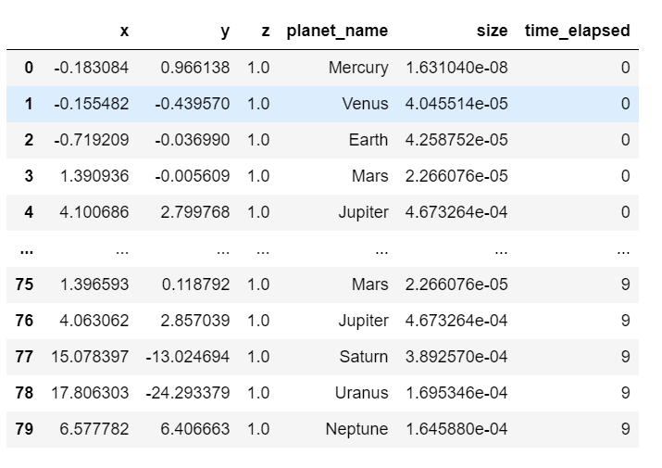
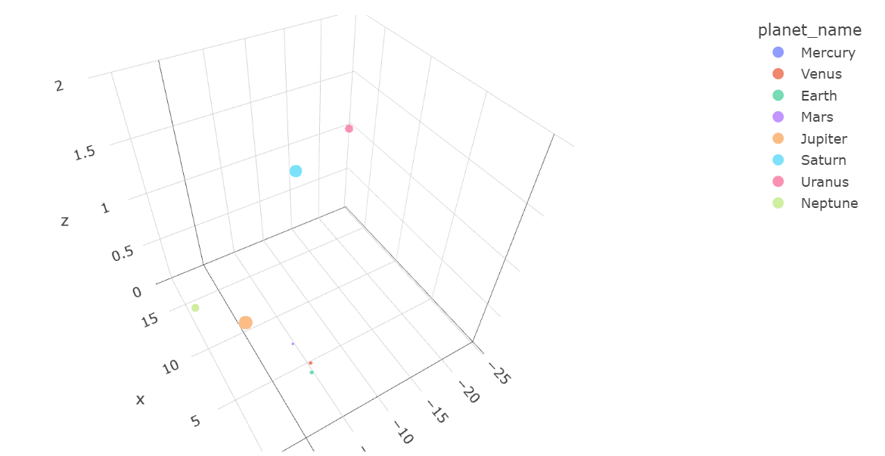
Creating Graphics and Datasets
Using dataframe objects to animate graphs in plotly
Solar system objects are able to keep body objects in lists
Body objects have coordinates which are changed based on different numerical methods
(Barycentric just means center of gravity)
Initial velocity- secant method
Initial position- from skyfield data
(Actual)
(Simulated)
Notes:
Zach

Slide 6
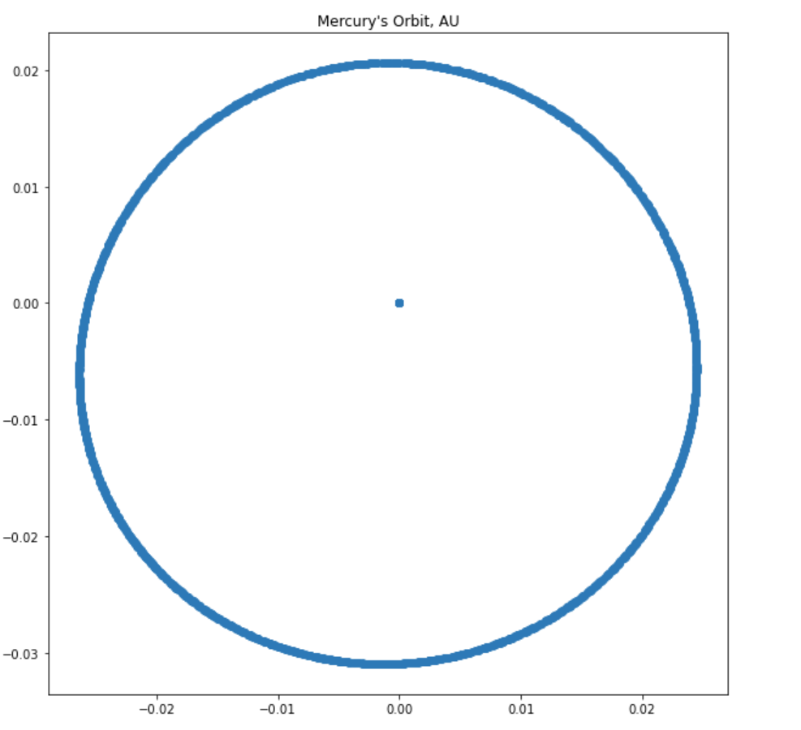
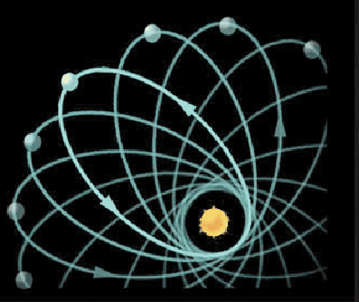
Interesting Observations
Mercury’s Strange Orbit
Graph is from 1900 to 2050
Mercury’s precession of perihelion not found (Sun at (0,0))
9.5 arcminutes per century, so wasn’t very visible on our time range
Notes:
Zach

Slide 7
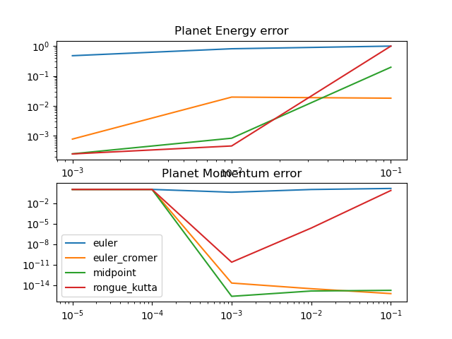
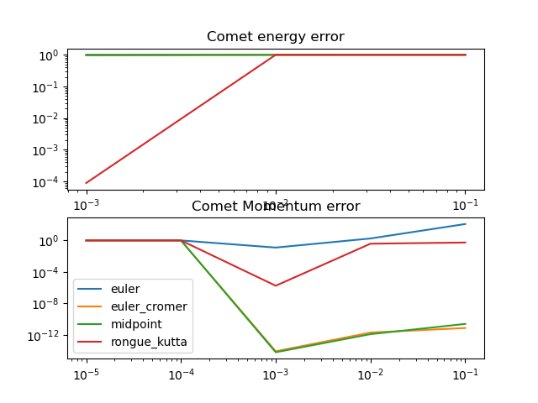
Numerical Methods & Errors
Space Complexity of ODE methods:
Euler’s method: O(N)
Euler Cromer’s method: O(N)
Midpoint Method: O(N)
4th Runge-Kutta O(4N)
Notes:
Zach

Slide 8
Sources of Error
Timestep length, limited amount of data to be stored, total time
Running the code would take a very long time to run if we set the time-step to be extremely small or set total time very high. (Animation would be very buggy and the data set would be huge).
As a result, we could only run the simulation for about a year and had limited data to work with.
Velocity approximation from secant line method as a possible source of error
Positions of Mars and Earth would be extremely off by a astronomically large proportion
All other planets were able to be simulated somewhat accurately despite this.

Slide 9
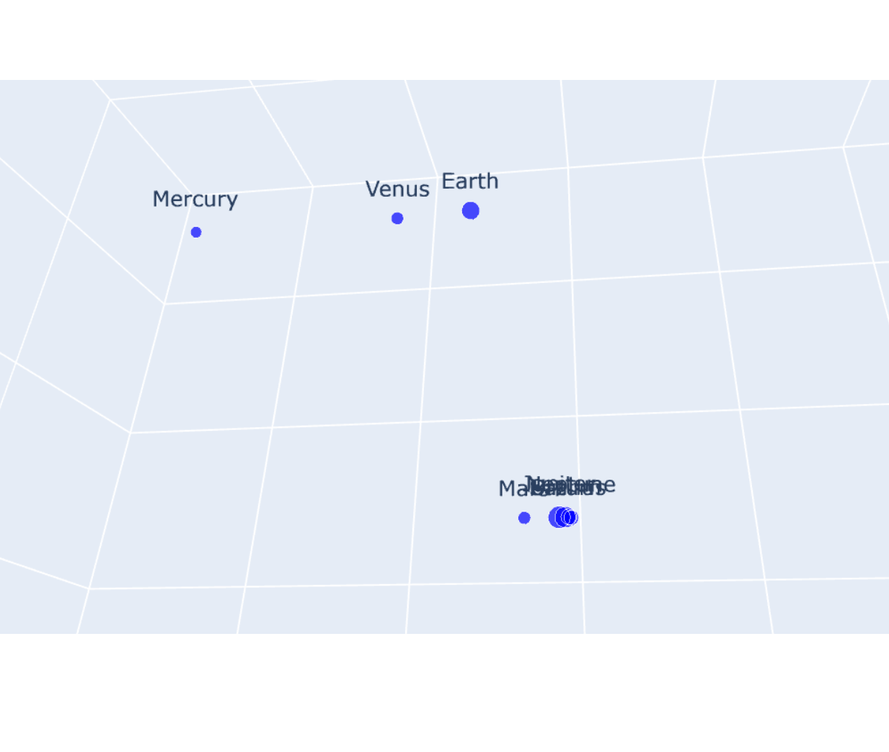
Difficulties/Complications
Format of model:
Having too many variables and different parameters.
Solved with class-based code
Animation not working:
Problems arose when running the code for too long. (Time-step and total time)
Resolved by only running the simulation for about a year.
Equations giving NaN values for the z-axis
Planets moving incorrectly in simulation

Slide 10
Questions

